Slide 1
Introductory Java Programming
An Introduction to the Java Language
App Design
Flat Rock Community Schools

Slide 3
Comments
Two ways to create a comment
//This is a comment
/*
* This
* way
* too
*/

Slide 4
Class Files
The actual file that you use to code the Java Language
Created after you create a Java Project in Eclipse
.java file extension
A “public class” means that any program can access the program (the code you type code inside the .java file)
The word “Tutorial” below is the name of the class file you created

Slide 5
main static subclass
Executes the program and tells it what to do as soon as it starts up.
This is written inside the class:
public static void main (String [] args) {
}
public: can be accessed from anywhere
static: means it can not interact with objects
(more on this later)
void: will not return any values, just execute
main: name of the sub file
() – includes parameters/arguments for the sub

Slide 6
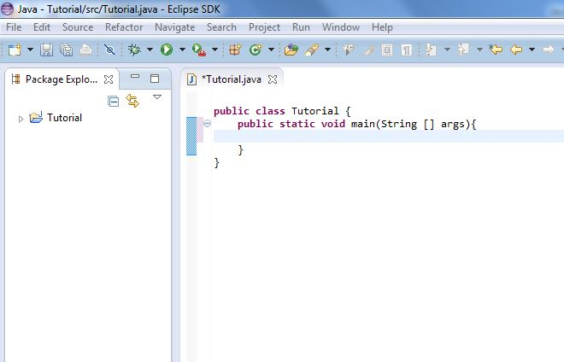
main static subclass example

Slide 7
main static subclass example
Note that both the class and the subclass has the nested curly brackets (start and end)

Slide 8
System.out.println (print line)
The most basic Java Program we can make:
System.out.println(“My Favorite Show is Big Bang Theory”);
Will ‘print’ this in the program:
My Favorite Show is Big Bang Theory

Slide 9
A few reminders:
Case Sensitivity
Nesting

