Slide 1
Introductory Java Programming
Variables & Strings
App Design
Flat Rock Community Schools

Slide 2
Variables
Variables are items that can constantly be manipulated in the programming language

Slide 3
Strings
Strings are lines that hold actual text
These lines can not be manipulated
For example:
String text = “If you’re playing pool online right now you’re missing a lot”;
In this line, the computer is thinking that anything inside the “” is letters and therefore can not be manipulated. It will simply keep that sentence together as one long sentence in whatever you use it for (a greeting, perhaps, for your app?).

Slide 4
System.out.println (print line)
Remember This?
The most basic Java Program we can make:
System.out.println(“My Favorite Show is Big Bang Theory”);
Will ‘print’ this in the program:
My Favorite Show is Big Bang Theory

Slide 5
Variables & Strings in the println
Now let’s add variables and strings to the class:
public class Tutorial {
public static void main (String [] args){
String text = “My Second Favorite Show is Once Upon a Time”
System.out.println(text);
Prints out:
My Second Favorite show is Once Upon a Time

Slide 6
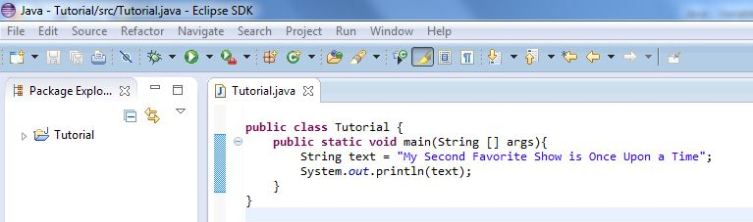
Variables & Strings in the println Example

Slide 7
Variables & Strings in the println Example

Slide 8
Symbols
When you want to add a symbol to your code, you can’t just type the symbol. If you do, many times it will confuse the language and cause an error.
To type a symbol, etc, you type a forward slash \ and then the symbol
For example:
\”Hello World\” will print: “Hello World”
\n \n will create a new line after the last “n”

Slide 9
Inserting Symbols & New Lines Examples

