Slide 1
JavaScript Arrays & Objects
Web Design II
Flat Rock Community Schools

Slide 2
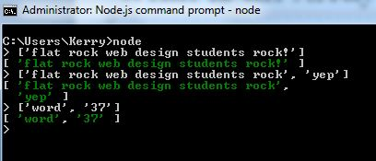
What is an Array?
An Array is a “collection” of items in a group
To create an array you use square brackets [ ]
Example: [‘hello’]→ [ ‘hello’ ]
Add more items to an array by typing a comma ,
Use letters and numbers

Slide 3
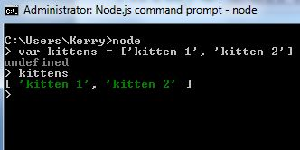
Arrays Con’t
You can add arrays to variables
var kittens = [‘kitten 1’, ‘kitten 2’]
kittens
[ ‘kitten1’, ‘kitten2’ ]

Slide 4
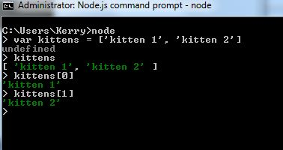
Arrays Con’t
Bring things out of the arrays
Use the same square brackets after the array variable
kittens[0]
‘kitten 1’
Arrays start counting at 0, not 1
For example, the 10th index is the 11th item

Slide 5
What is an Object?
An object is used to store items that have very specific names to them
To create an object you use curly brackets { }
Example:
credentials = { username: ‘leonard’, password: ‘hofstadter’ }
Add more items to an array by typing a comma ,

Slide 6
Objects
Pull items out of your objects
Use the value of the object
credentials = { username: ‘leonard’, password: ‘hofstadter’ }
credentials[‘username’]
‘jeff’
OR
credentials.username
‘jeff’

Slide 7
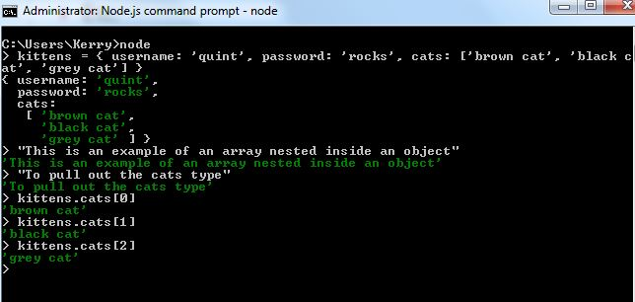
Nesting Arrays & Objects
You can have:
Arrays nested inside Objects
Objects nested inside Arrays
Arrays nested inside other Arrays

