Slide 1
JavaScript Booleans & Loops
Web Design II
Flat Rock Community Schools

Slide 2
What is a Boolean?
A Boolean value represents:
Truth of Falsehood
On or Off
Yes or No
There are only two possible values of this type.
true or false
Boolean Values are generally the result of comparisons you make in your JavaScript programs.
a === 4
The code will test to see whether the value of the variable is equal to the number 4. If it is, the result of the comparison will be true. If it not equal to 4, the result of the comparison is false.
What will show up

Slide 3
Boolean’s Con’t
The computer will solve things people already know
1 > 6
false
1 < 6
true
You can do this with any sort of data
The “=“ operator
Equals sign is used to set a variable
Therefore, use three equal signs ===
For example:
1 === 1
true

Slide 4
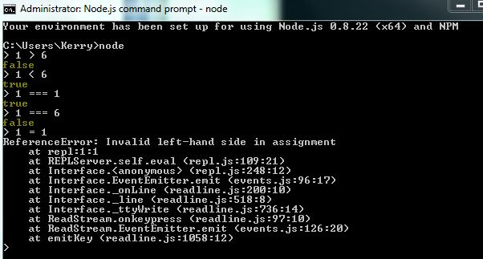
More Examples of Booleans

Slide 5
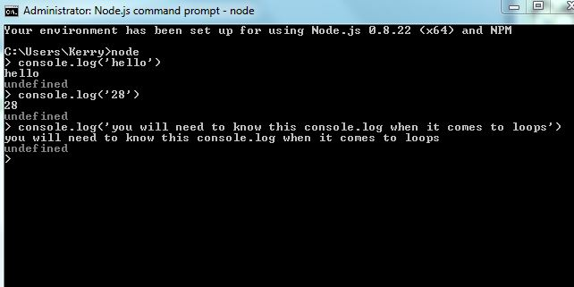
console.log(‘’);

Slide 6
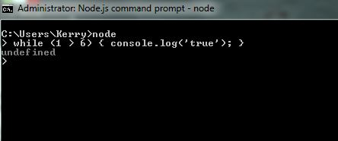
Loops
Loops in programming automatically run one line of programming more than once (in essence, it loops a true line over and over again, like repeat on a mp3 player until the line or statement becomes false)
While Loop
Tests against the condition
While (1 > 6) { console.log(‘true’); }

Slide 7
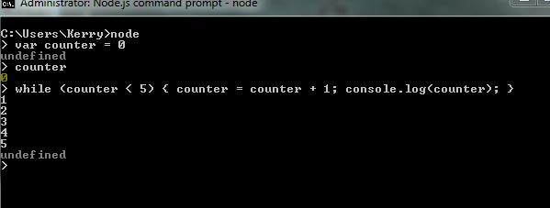
Loops Con’t
Counter Variables
var counter = 0

Slide 8
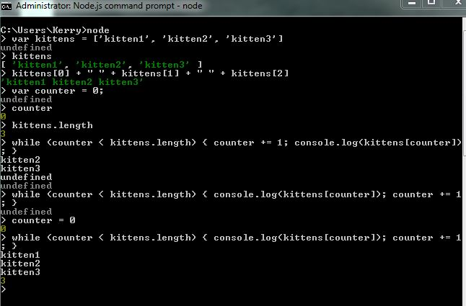
Loops Con’t

Slide 9
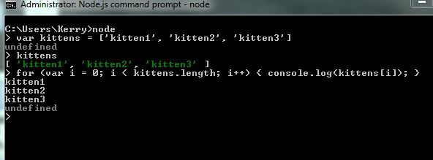
for Loop

