Slide 1
JavaScript Functions
Web Design II
Flat Rock Community Schools

Slide 2
What is a Function?
A way to pull out a “block of code” and save it so it can be “called out” whenever you want.
Function say_hello( ) {
console.log (‘hello’);
Console.log (‘world’);
}

Slide 3
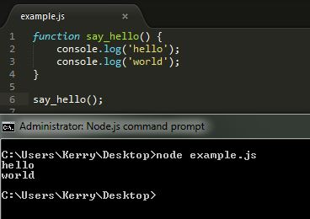
Declaration

Slide 4
Function Definition Con’t..
A JavaScript function is a "recipe" of instructions (i.e., statements or commands) whose purpose is to accomplish a well-defined task. When the JavaScript interpreter (i.e., your browser) executes a function, it processes these instructions, one by one, until there are no more instructions in the function to execute.
For example, a JavaScript function whose purpose is to compute the square of a number might be defined as follows:
function square (number) {
var result = number * number;
return result;
}

Slide 5
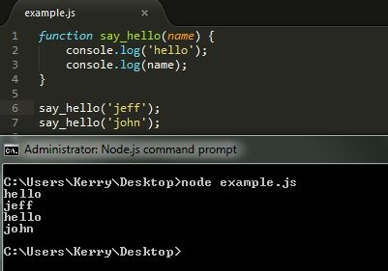
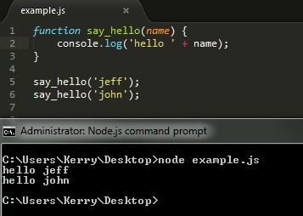
Parenthesis & Parameters
Parenthesis allow you to pass information into your function so you can use it later – aka Parameters

Slide 6
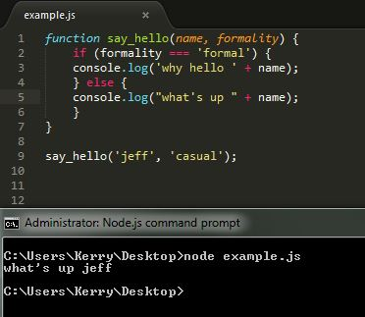
Adding more than one Parameter

Slide 7
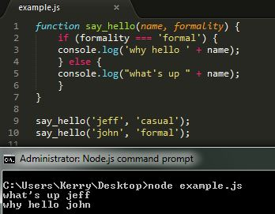

Slide 8
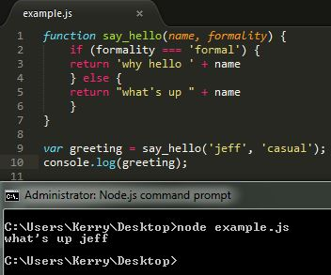
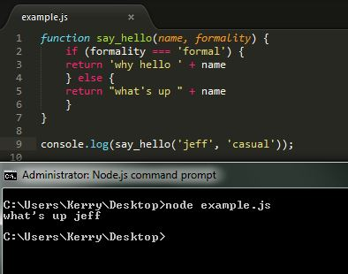
Returns
Some functions can be thought of as "processing units" that accept data from one end and produce results at the other. A function's input is called its parameters; its output is called the return value.

Slide 9
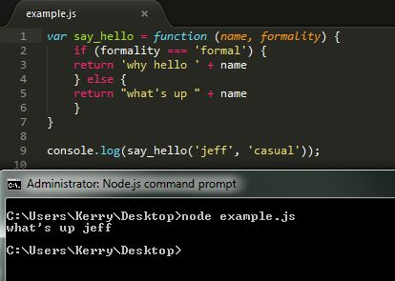
Assigning a Function to a Variable

Slide 10
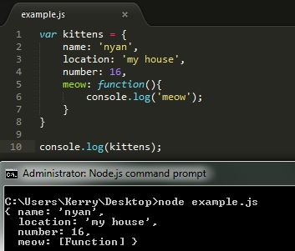

Slide 11
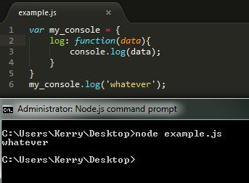
What does console.log really mean?
“console” is an object that holds various info. and functions that can be used in order to log out information into the development console (node/web browser) to show that it’s running properly.
“log” is a function in console that writes any text you may have into the development console (node/browser)

