Slide 1
JavaScript If/Else Statements & Comparisons
Web Design II
Flat Rock Community Schools

Slide 2
Comparisons
console.log(2 === 2) – EQUALS TO
true
console.log(2 === 8)
false
console.log(2 !== 8) – NOT EQUALS TO
true
console.log(2 !== 2)
false

Slide 3
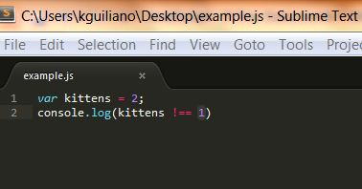
Comparisons Con’t
var kittens = 2;
console.log(kittens !== 3)

Slide 4
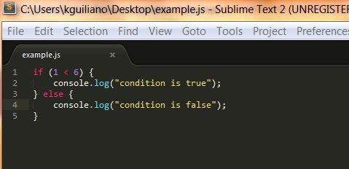
What is an If/Else Statement?
An If/Else Statement is used for when you need to make a decision between one or more conditions.
You can put any sort of condition in the top initial condition. You can use operators, pieces of data or variables, etc.

Slide 5
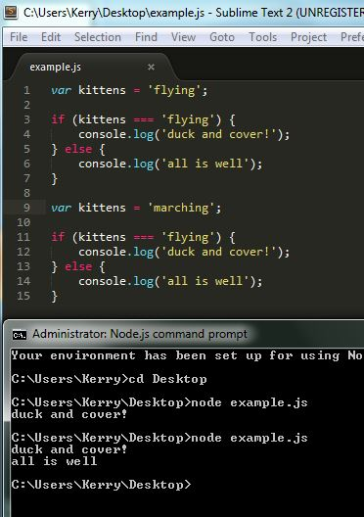
If/Else Statements Con’t...

Slide 6
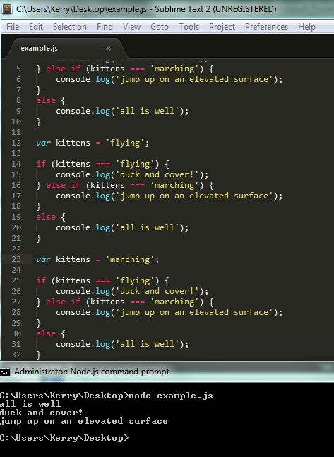
If/Else Con’t..
To make sure the statement is evaluated correctly in an If/Else Statement, add an else if into the middle of it.

