Slide 1
JavaScript Strings, Numbers (Integers) and Variables
Web Design II
Flat Rock Community Schools

Slide 2
What is a String?
A String is a bunch of characters or text put together into a word, sentence or more.
It is typed with double quotes
“Hello World”
Hello World
You can write anything inside a string
The computer will keep it is a string and will assume that you typed it in exactly how you mean it to be.
You can add strings together
“Hello” + “World”
HelloWorld

Slide 3
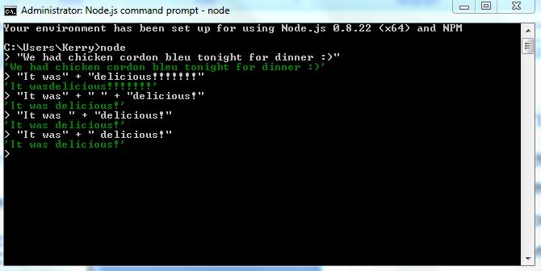
More Examples of Strings

Slide 4
Integers (Numbers) in JavaScript
You can do math in JavaScript
Uses the same syntax as normal computer calculator
Addition +
Subtract –
Multiplication *
Division /
Order of Operations
(5*2)/6
JavaScript will deal with anything as a decimal
It will not deal with fractions
Becomes useful when you’re calculating how big to make items, etc.

Slide 5
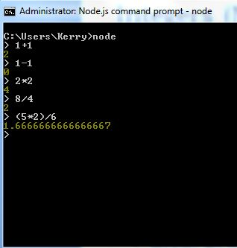
Examples of Integer Use

Slide 6
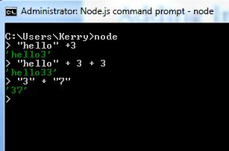
Adding Integers & Strings?
You can add Strings and Integers
“hello” + 3
‘hello3’
“hello” + 3 + 3
‘hello33’
“3” + “7”
‘37’

Slide 7
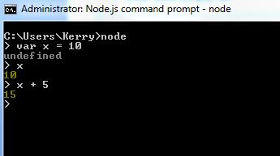
Variables
Variables are abstract representations of a other things.
Variables come in handy when you have a lot of characters you need to continuously type
When introducing a new variable
You use the word: var
var x = 10

Slide 8
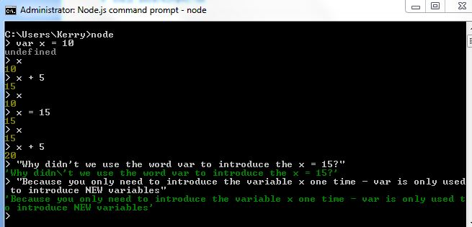
Variables Con’t

Slide 9
Variables Con’t
Use words as variables so other people can understand them
var greeting = “Hello”
greeting
Hello

